Slide 1

Stat-O-Matic Baseball
Exploring Major League Baseball data from 1990 to 2021
Presented by Zachary Clarke

Slide 2
CONTENTS
01
Quick Facts about the Stats
Defining the stats and their purpose
02
Exploring the MLB Data
Looking at teams stats from 1990 - 2021
03
The Moneyball Team
A quick history of the 2002 Oakland Athletics
04
Machine Learning Model
Predicting Division Winners and World Series Champions
05
Conclusion
My final thoughts about the project

Slide 3
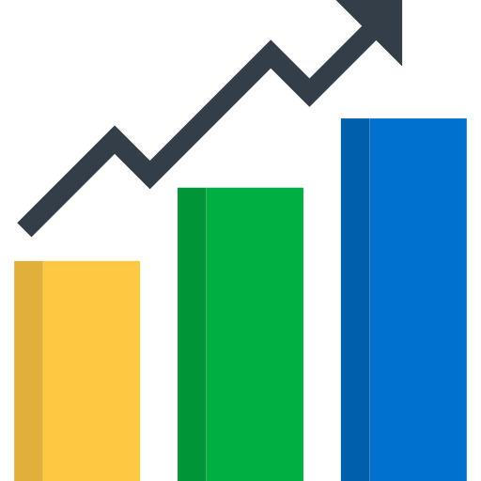
01
Quick Facts about the Stats

Slide 4
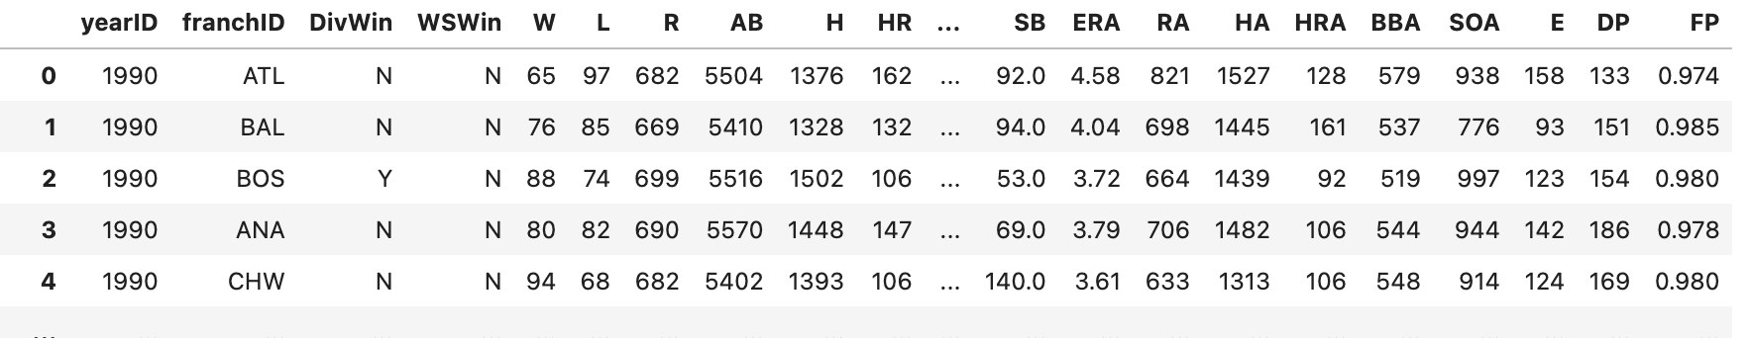
the Dataset
The Dataset is MLB Team Statistics from 1990 - 2021
General Stats
yearID - Year Identifier
franchID - Franchise Identifier
W - Wins
L - Losses
G - Games, there is 162 games in a season
DivWin - Division Winners
WSWin - World Series Winners
Offensive Stats
R - Runs
AB - At Bats
H - Hits
HR - Home Runs
BB - Walks
SB - Stolen Bases
Defensive Stats
ERA - Earned Runs Average
RA - Runs Against
HA - Hts Against
HRA - Home Runs Against
BBA - Walks Against
SOA - Strike Out Against
E - Errors
DP - Double Play
FP - Fielding Percentage

Slide 5

02
Exploring MLB Data

Slide 6
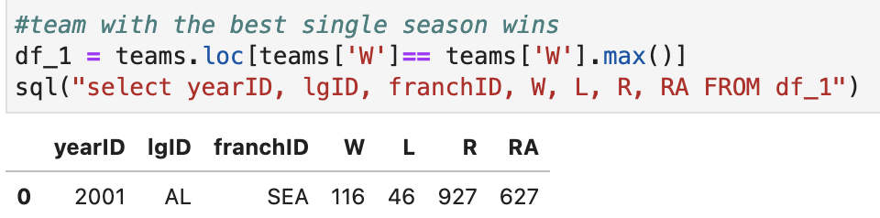
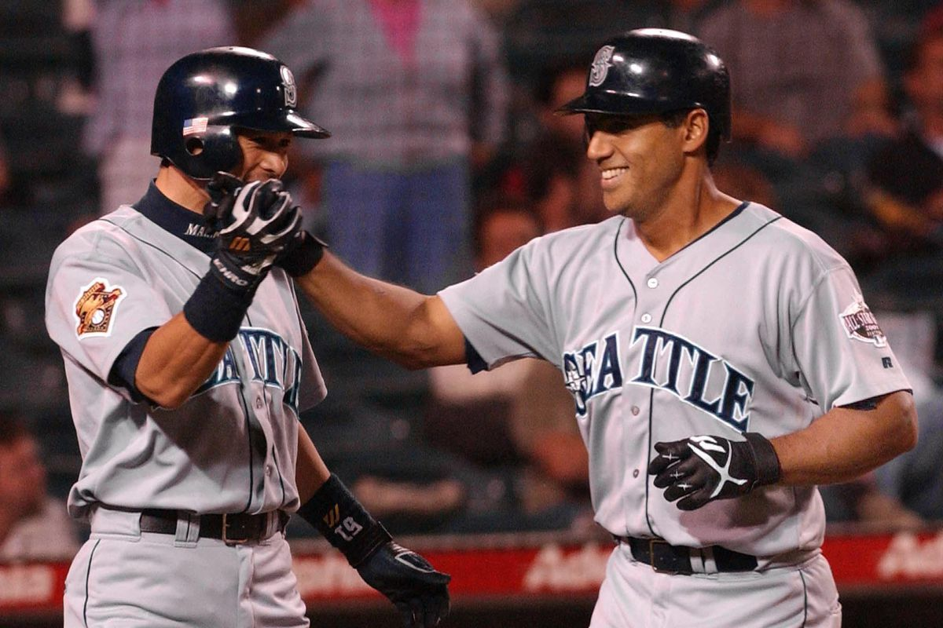
Most Wins in a Season

Slide 7
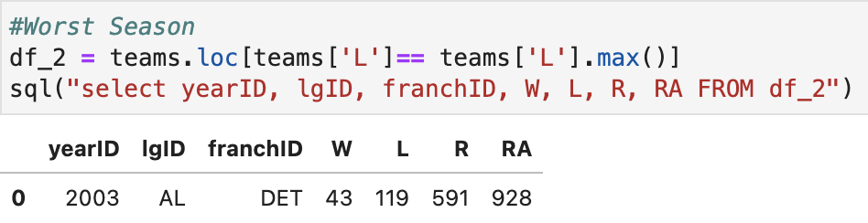
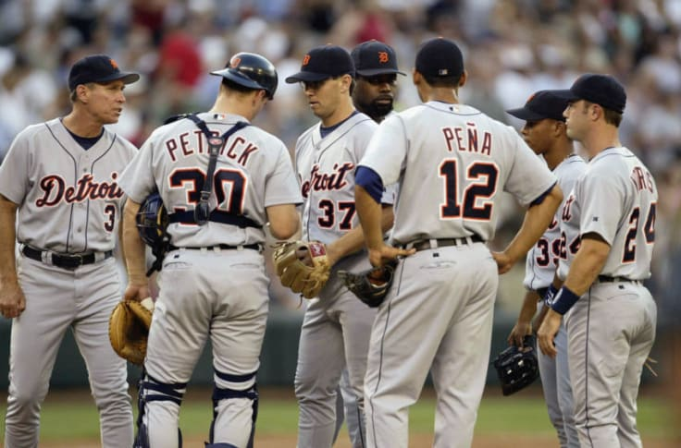
Most Losses in a Season

Slide 8
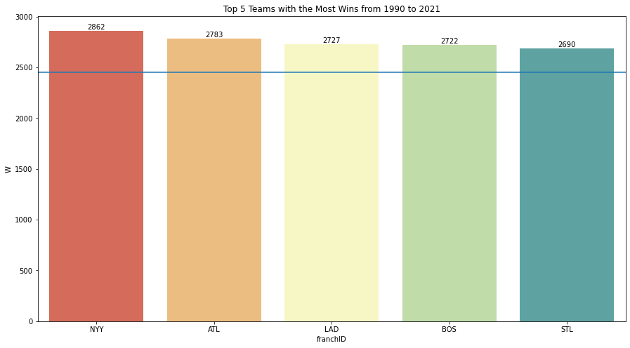
The Best Franchises
Mean Line = 2449.866666666667

Slide 9
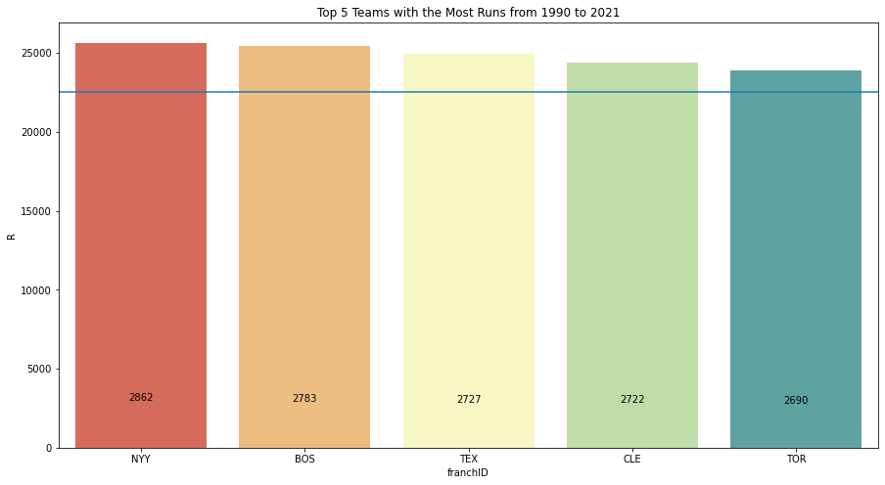
Top Runs Scored By Franchises
Mean Line = 22557.833333333332
*Circled teams are also in the Top 5 franchises with the most wins

Slide 10
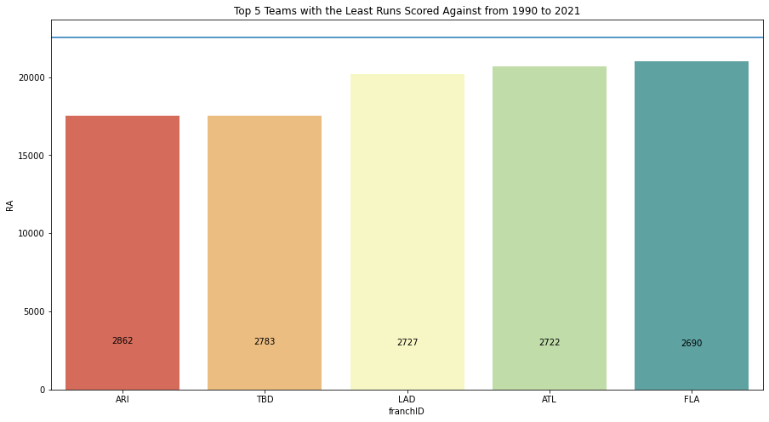
Top 5 Teams with the Least Runs Scored Against
Mean Line = 22557.833333333332
*Circled teams are also in the Top 5 franchises with the most wins
Notes:
4 of the top 5 teams who have the most wins are also in the Top 5 of either Run Scored or Least Amount of Run scored against them.

Slide 11
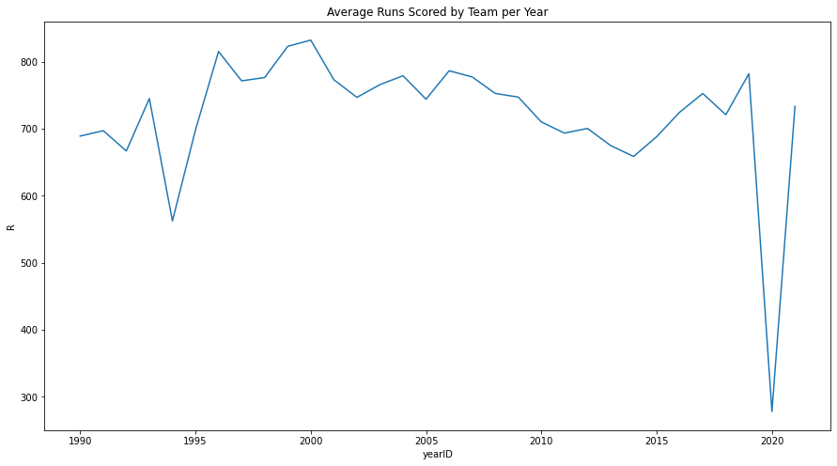
Runs pt. 1
1994 -1995 Player’s Strike. The season was left unfinished at around 100 games.
Season Shortened to 60 games due to the Covid-19 pandemic
Notes:
So clearly the amount of runs a team scores as well as how many runs they give up is important
This logical; if you score more runs than the team you’re playing you will win
Let’s take a look at average runs throughout the years
Everything falls in the 700 - 800 runs a season
Explain the outliers

Slide 12
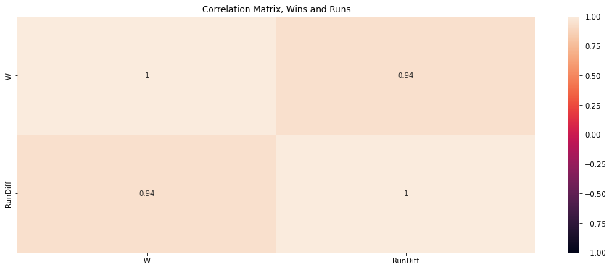
Runs pt. 2
R - RA = Run Differential A.K.A RunDiff
Notes:
Utilizing Runs and Runs Against stats I computed the Run differential for each team
Simply put the difference between the amount of runs a team scored and how many runs the allowed.
Strong positive correlation between Run Differential and Wins, Almost 1 to 1

Slide 13
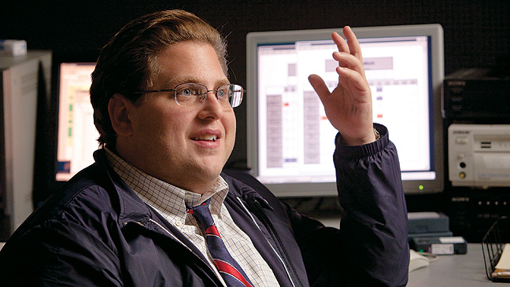
Runs pt. 3
“We need to win 99 games to make the playoffs. We need to score at least 814 runs and allow no more the 645”
In other words, a run differential of 169...
Notes:
You’re working on a baseball team as a data analyst. One of your teammates says this to the team’s general manager…
Quote
Let’s use a scatter plot and linear regression model to predict the amount wins we would get with a run differential of 169 and back up our teammates point

Slide 14
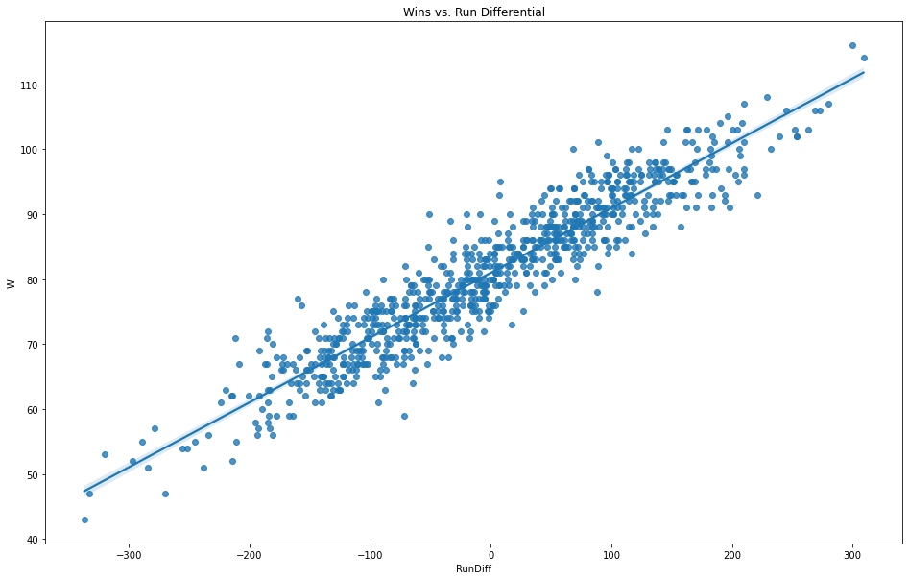
Runs pt. 4
Notes:
This scatter plot visualizes the correlation
From the scatter plot you can see the strong positive correlation between Run Differential and wins
As run differential goes up so does wins
Lets see how many wins a run differential of 169…
So maybe? Let’s get a little more precise

Slide 15
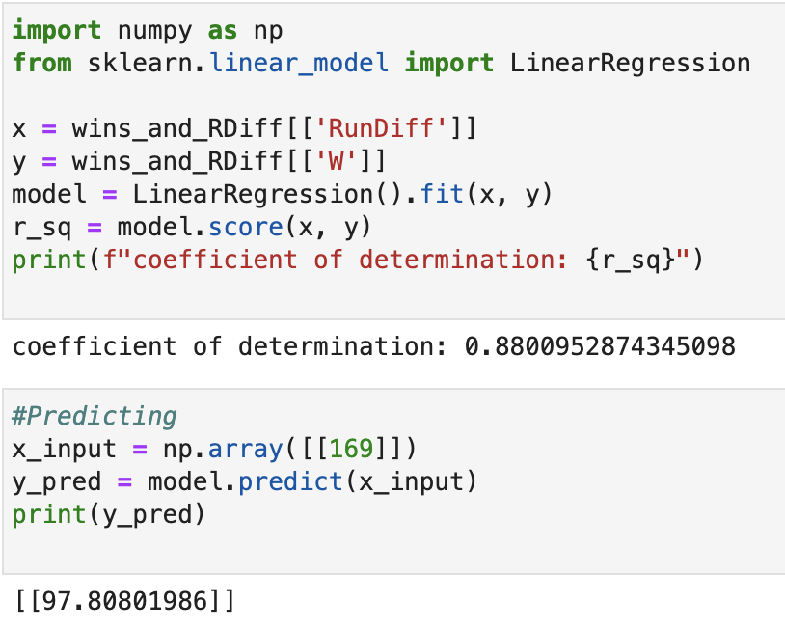
Runs pt. 4 (Linear Regression Model Prediction)
How well the model explains the correlation between the two variables (0 is the lowest and 1 is the highest).
Run Differential Input
Predicted Number of Wins
Notes:
Used Linear regression to make a prediction about wins based on the run differential.
*Model accuracy
*input
*prediction
Our team was very close! Hopefully 97-98 wins is enough to get us to the playoffs

Slide 16
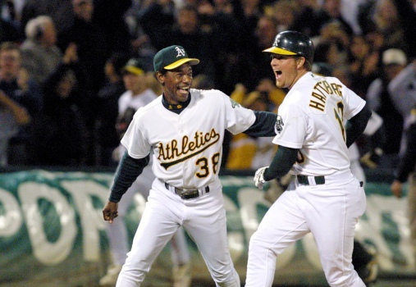
03
The Moneyball Team
2002 Oakland Athletics

Slide 17
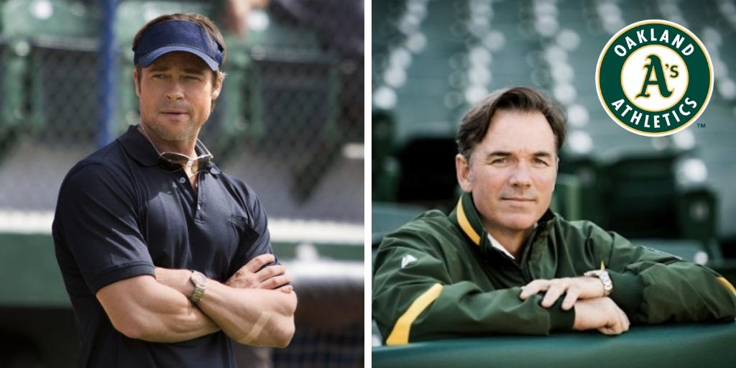
Super Quick Overview
Oakland Athletics 2002 General Manager Billy Beane
One of the poorer MLB franchises
Didn’t have enough money to sign expensive star players, but wanted to stay competitive
Pioneered the idea of using sabermetrics and statistics to find value in overlooked players.
correlation to runs and runs against
In 2002, the Oakland Athletics won 103 games, won their division, and made the playoffs
They did not win the World Series
Notes:
Found what stats correlated to runs and runs against
Went on the 4th longest win streak with 20 wins

Slide 18

04
Machine Learning Model
Can I create a Machine Learning Model that makes a prediction on the Oakland Athletics Winning their Division in 2002? On winning the world series?

Slide 19
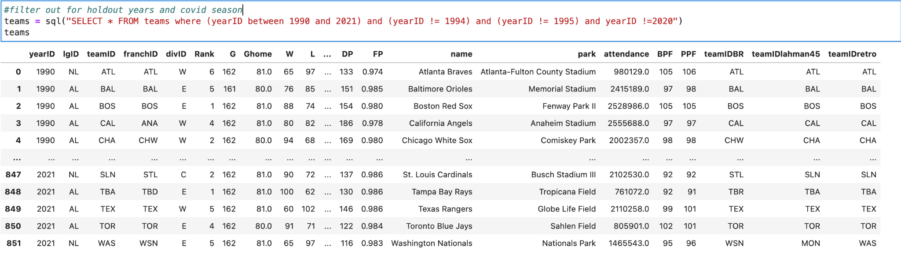
ML - Cleaning the dataset
I removed the 1994, 1995, and th 2020 seasons from the dataset

Slide 20
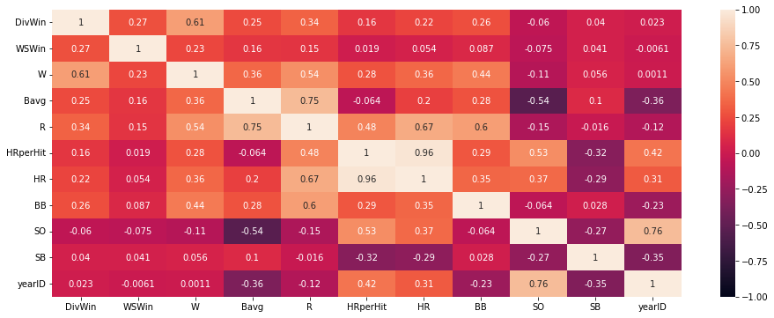
ML - Offensive Correlation Matrix
Notes:
Used the correlation matrix to see which variables I wanted to choose for my ML Model
Split it into offensive and defense to make it more viewable

Slide 21
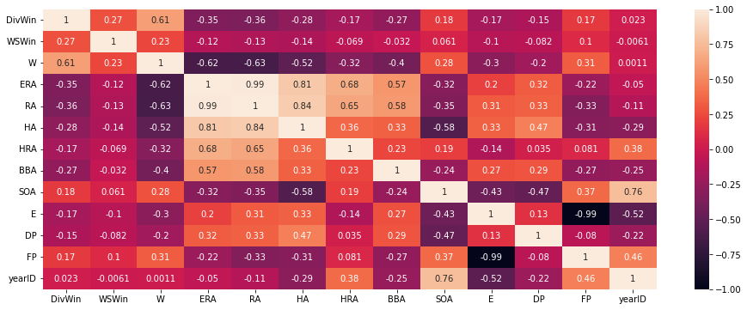
ML - Defensive Correlation Matrix

Slide 22
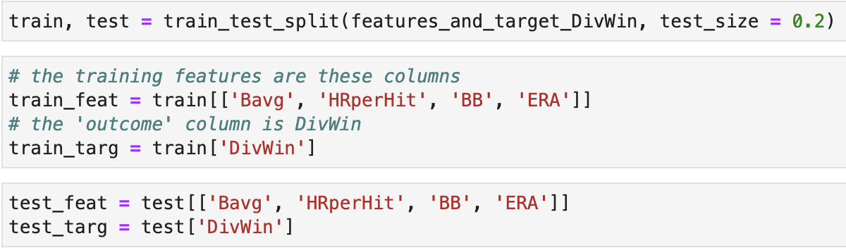
ML - Training and Testing
The input variables: Bavg, HRperHit, BB, and ERA
Output variable: DivWin
Splitting the data in two…
80 percent for training
20 percent for testing

Slide 23
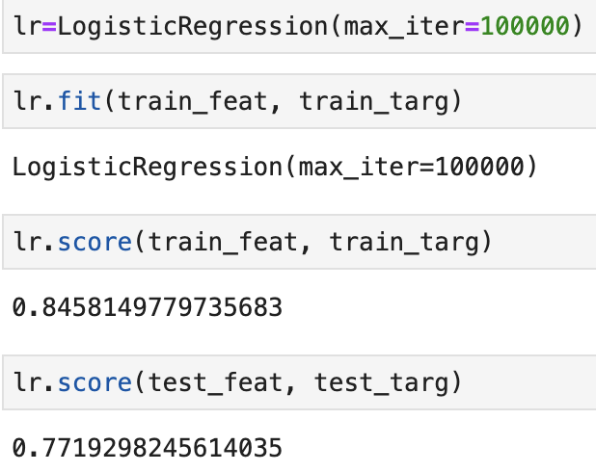
ML - Logistic Regression
Creating the model from 100,000 iterations
How well the training for the model explains the correlation between the input and output variables (0 is the lowest and 1 is the highest).
How well the test for the model explains the correlation between the input and output variables (0 is the lowest and 1 is the highest).
We want these two scores to be as close as possible for optimum prediction results.
Notes:
Using Logistic Regression
Logistic regression is a process of modeling the probability of a discrete outcome given an input variable.

Slide 24
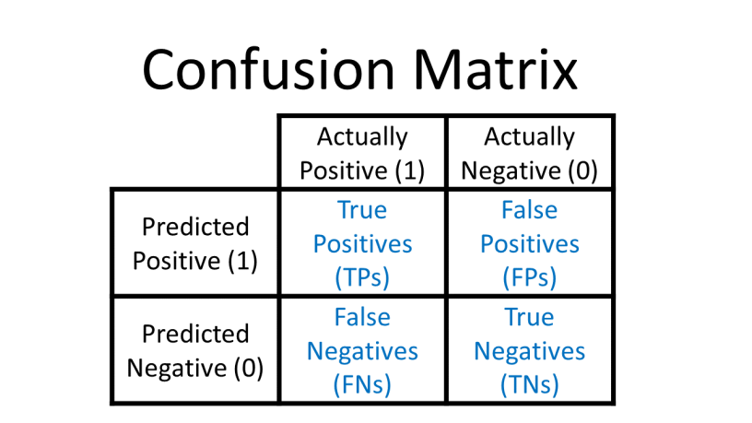
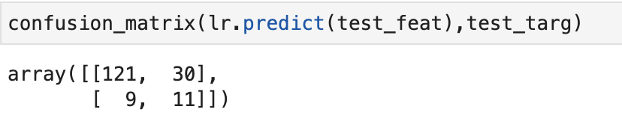
ML - Confusion Matrix

Slide 25
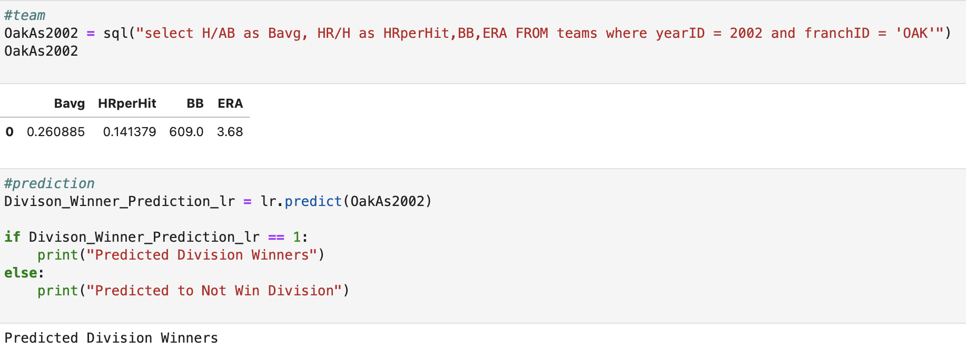
ML - Predicting Division Winners
Predicted Division Winners

Slide 26
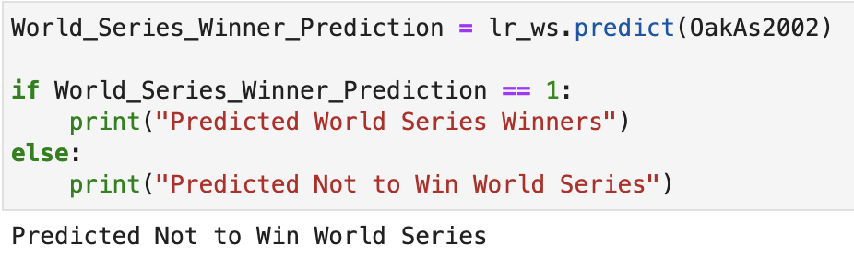
ML - Predicting World Series Winners

Slide 27
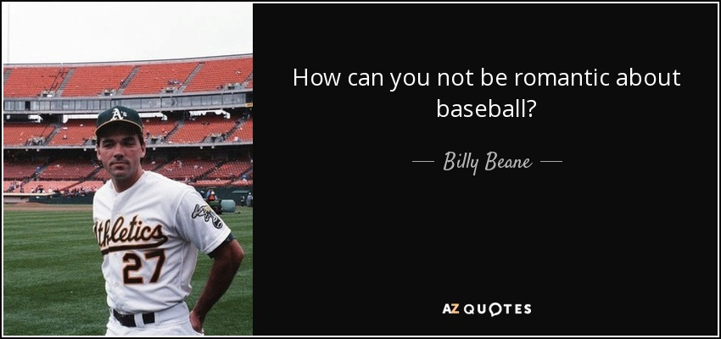
05
Conclusion
stats in
Zach Clarke
Notes:
Although this was a major simplification of the models the actually utilized in the moneyball event,
it was great to get a base understanding of these types of models work
Practical applications might include understanding which statistics a team has to improve to create a winning season.
And finding players that are more valuable to your teams then another
influencing trades, free agency etc.
Billy Beane was quoted saying

Slide 28

THANK YOU

